Slide 1
Restaurant Automation System
By Bedre Pratik Ashrapppa
C Geetesh
Banothu Gayatri
Bhargave Naidu

Slide 2
Materials
2 drinking glasses
Table salt
2 eggs
Water
Found around the house!

Slide 3



Procedure
Requirement Specification
Design
Implementation
Testing

Slide 4
Hypothesis

Slide 5
The RAS will help restaurant owners automate day–to-day activities and mitigate human error.

Slide 6
Functionalities/Screens
Manager Screen
Helps manager navigate through his assigned tasks and authorities.

Slide 7
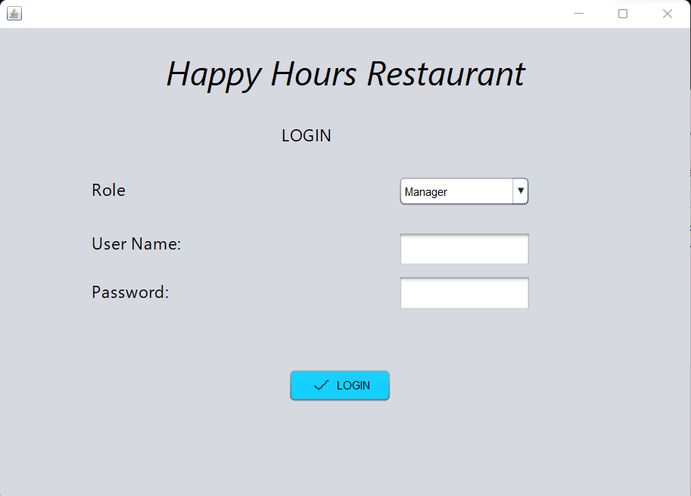
Login Page

Slide 8
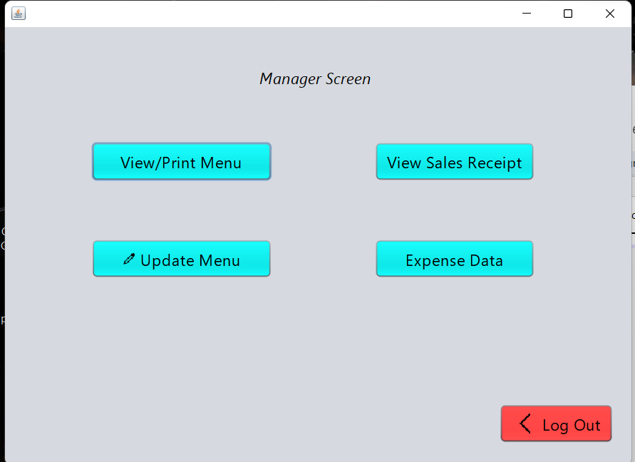
Manager Page

Slide 9
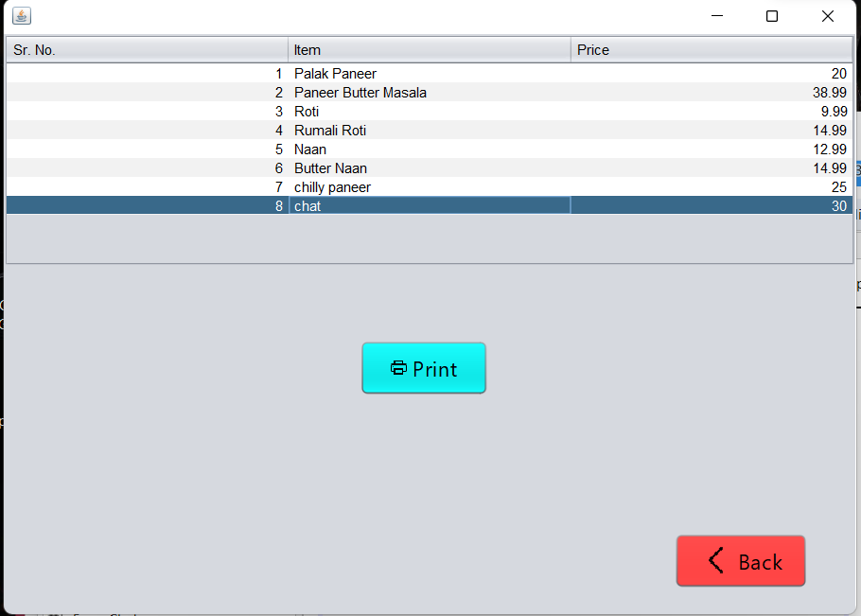
Menu Page

Slide 10
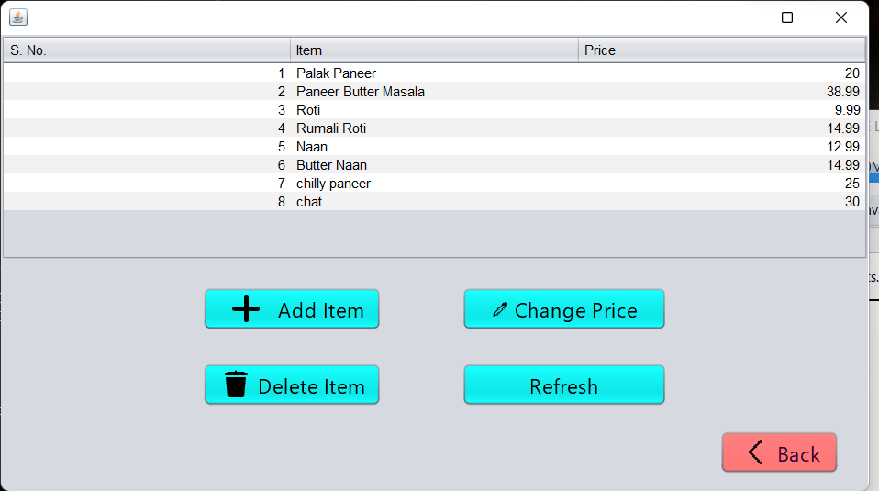
Edit Menu Page

Slide 11
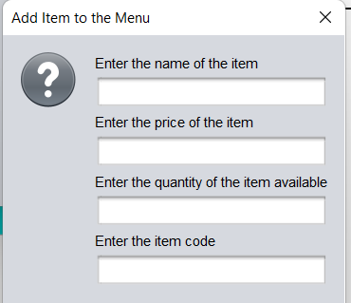
Add item

Slide 12
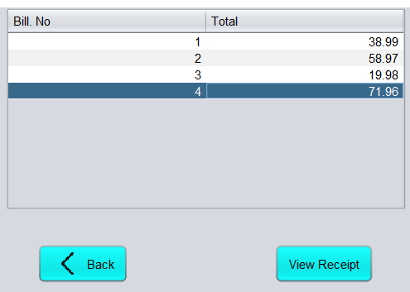
Sales receipts page

Slide 13
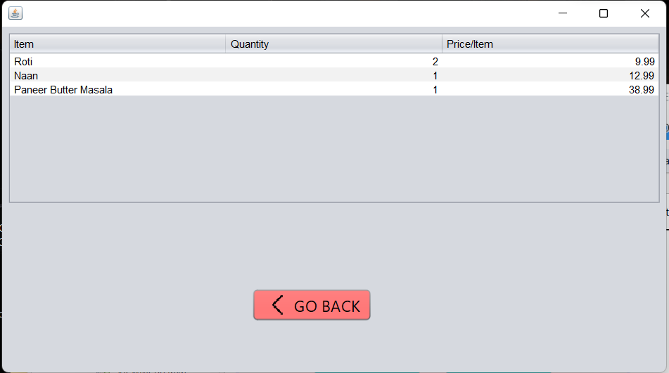
Detailed sales receipt

Slide 14
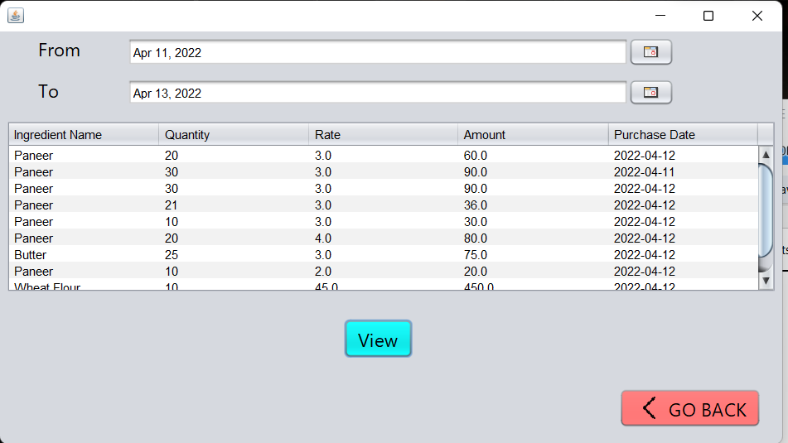
Expense reports

Slide 15
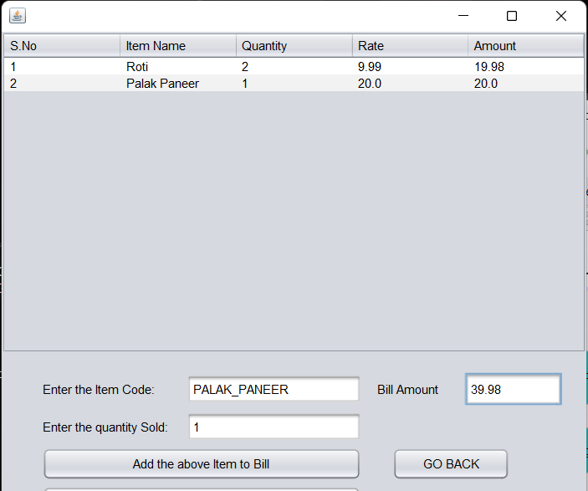
Add item to bill

Slide 16
Functionalities/Screens
Clerk Screen
Helps the clerical staff navigate through their assigned tasks and authorities.

Slide 17
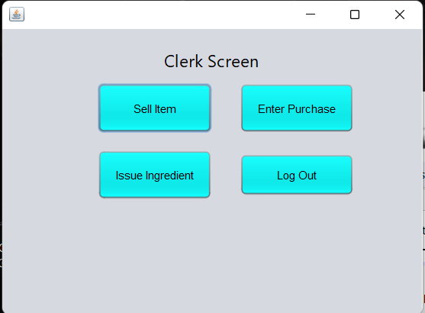
Clerk Screen

Slide 18
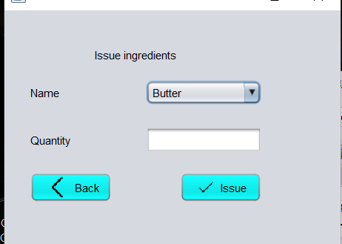
Issue ingredients

Slide 19
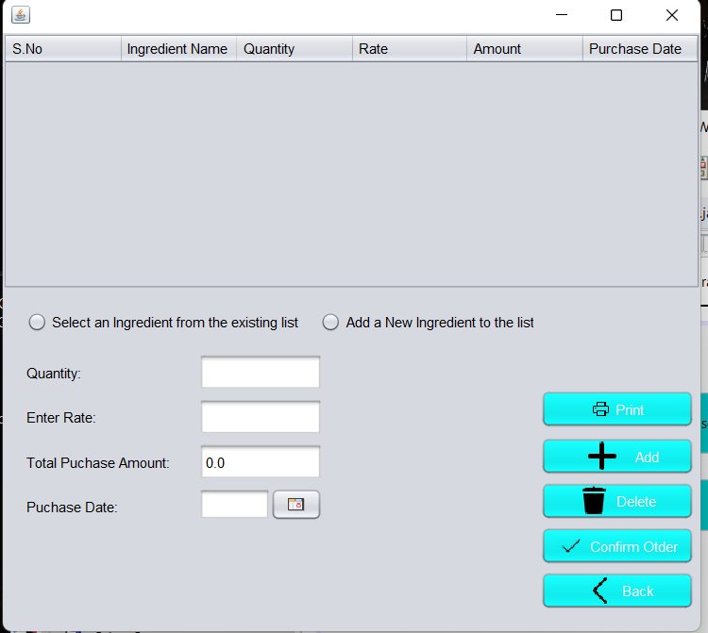
Bill page

